Slide 1
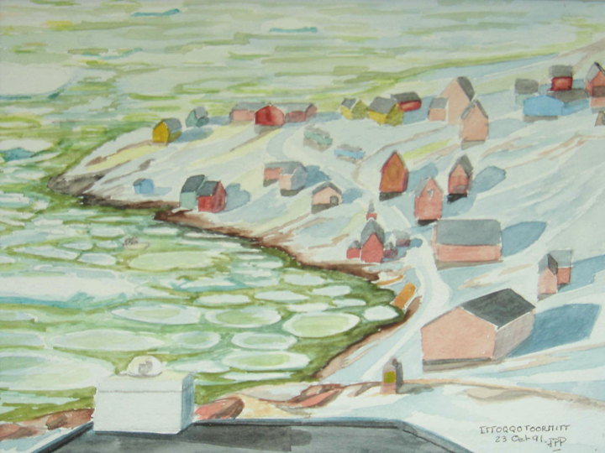
Evaluation of Satellite NO2 Stratospheric Columns with the SAOZ/NDACC UV-Vis Network
J.-P. Pommereau¹, F. Goutail¹, A. Pazmino¹,
D. Ionov^{1,3}, F. Hendrick², and M. Van Roozendael²
[1] LATMOS, CNRS, and University of Versailles Saint Quentin, Guyancourt, France
[2] Belgian Institute for Space Aeronomy (BIRA-IASB), Brussels, Belgium
[3] Department of Atmospheric Physics, St. Petersburg State University, Russia

Slide 2
NO₂ more complex than ozone for several reasons
Tropospheric contribution larger than for O₃
(PBL pollution, Lightning NOx in UTLS)
Limited information on profile climatology below
20 km and during polar permanent day and night
(models little representative of the troposphere)
Photochemical diurnal variation
ESA ACVE March 2013

Slide 3
SAOZ NO₂
following NDACC UV-Vis WG recommendations
Slant columns at sunrise and sunset by zenith sky observations between 86°-91°SZA
NO₂ cross-sections at low temperature (Vandaele et al.)
Slant converted into vertical columns using Air Mass Factors (AMF) calculated from IASB-BIRA zonal climatologies
ESA ACVE March 2013

Slide 4
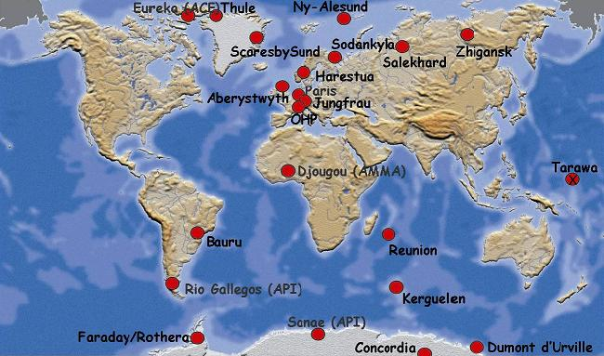
SAOZ network selected stations
Arctic
Antarctic
Mid-Lat
Tropics

Slide 5
SAOZ NO₂ PROFILES CLIMATOLOGY
AMF BIRA-IASB look-up tables from:
Satellite profiles HALOE, POAM III above 20 km (Lambert et al. 2000)
Complemented below 20 km by SAOZ-B short and long duration balloon profiles at high and middle northern latitudes and the southern tropics
Ex: northern mid-latitudes
Sunrise
Sunset
ESA ACVE March 2013

Slide 6
Comparison with SATELLITES
GOME GDP4, SCIAMACHY Strato (IUPB), OMI Strato (NASA), GOME 2 Strato (IUPB)
Satellites: nadir viewing, subtraction of modelled tropospheric NO₂, correction for clouds (Ghost column)
SAOZ zenith sky observations less sensitive to PBL tropospheric pollution
ESA ACVE March 2013

Slide 7
Correction for diurnal photochemical variation
GOME2
1D Photochemical model simulations (stratosphere only)
Latitude and seasonal dependence
Satellites columns normalised to SAOZ sunrise column at 90°SZA

Slide 8
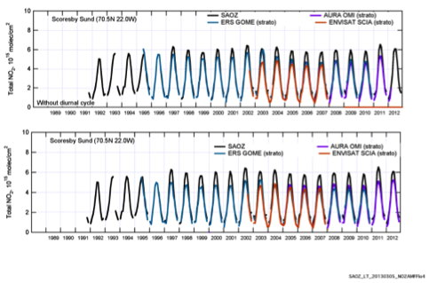
ARCTIC: Scoresbysund Greenland (never polluted)
Original data
Diurnal variation corrected
Satellites low biased compared to SAOZ in summer
ESA ACVE March 2013

Slide 9
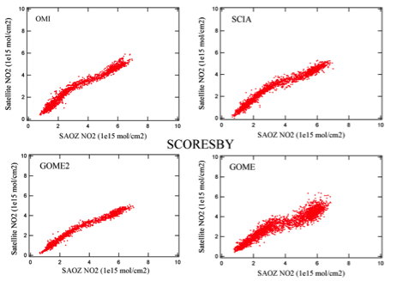
SCORESBYSUND
Correlation SAT NO2 / SAOZ NO2
Larger noise on GOME
Not linear. Different behaviour at low and high NO₂
ESA ACVE March 2013

Slide 10
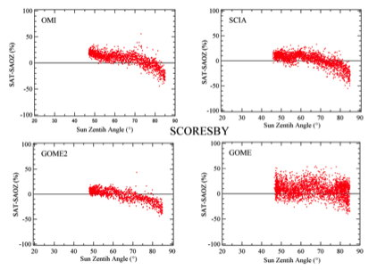
EXPLANATION: SZA DEPENDENCE
All satellites cut at SZA>85°
GOME less dependent but noisy
Overestimation at high sun, underestimation at low sun
(Not SAOZ since always same SZA)
GOME less dependent but noisy
ESA ACVE March 2013

Slide 11
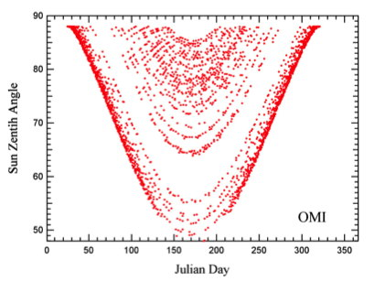
But why underestimation of satellite columns in the summer?
SZA at OMI overpass
Summer measurements at low sun!
From ascending orbit at 21 loc during permanent day instead of descending orbit at 9 loc. Diurnal variation correction wrong.

Slide 12
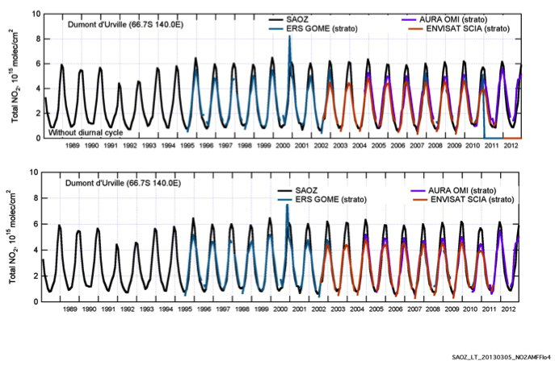
DUMONT D’URVILLE
Satellites low biased compared to SAOZ

Slide 13
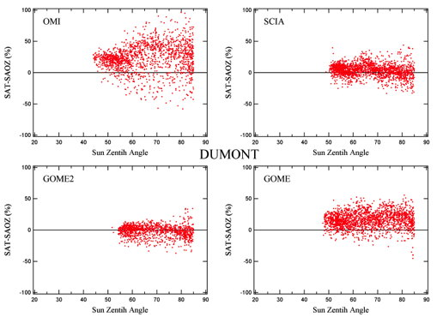
DUMONT D’URVILLE
SZA DEPENDENCE

Slide 14
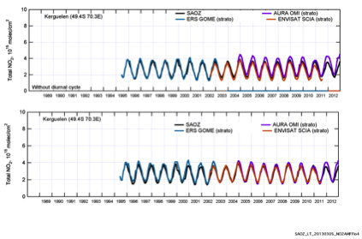
Mid-Latitude: Kerguelen (never polluted)
GOME and OMI high biased in summer,
SCIA better but low biased in winter
ESA ACVE March 2013

Slide 15
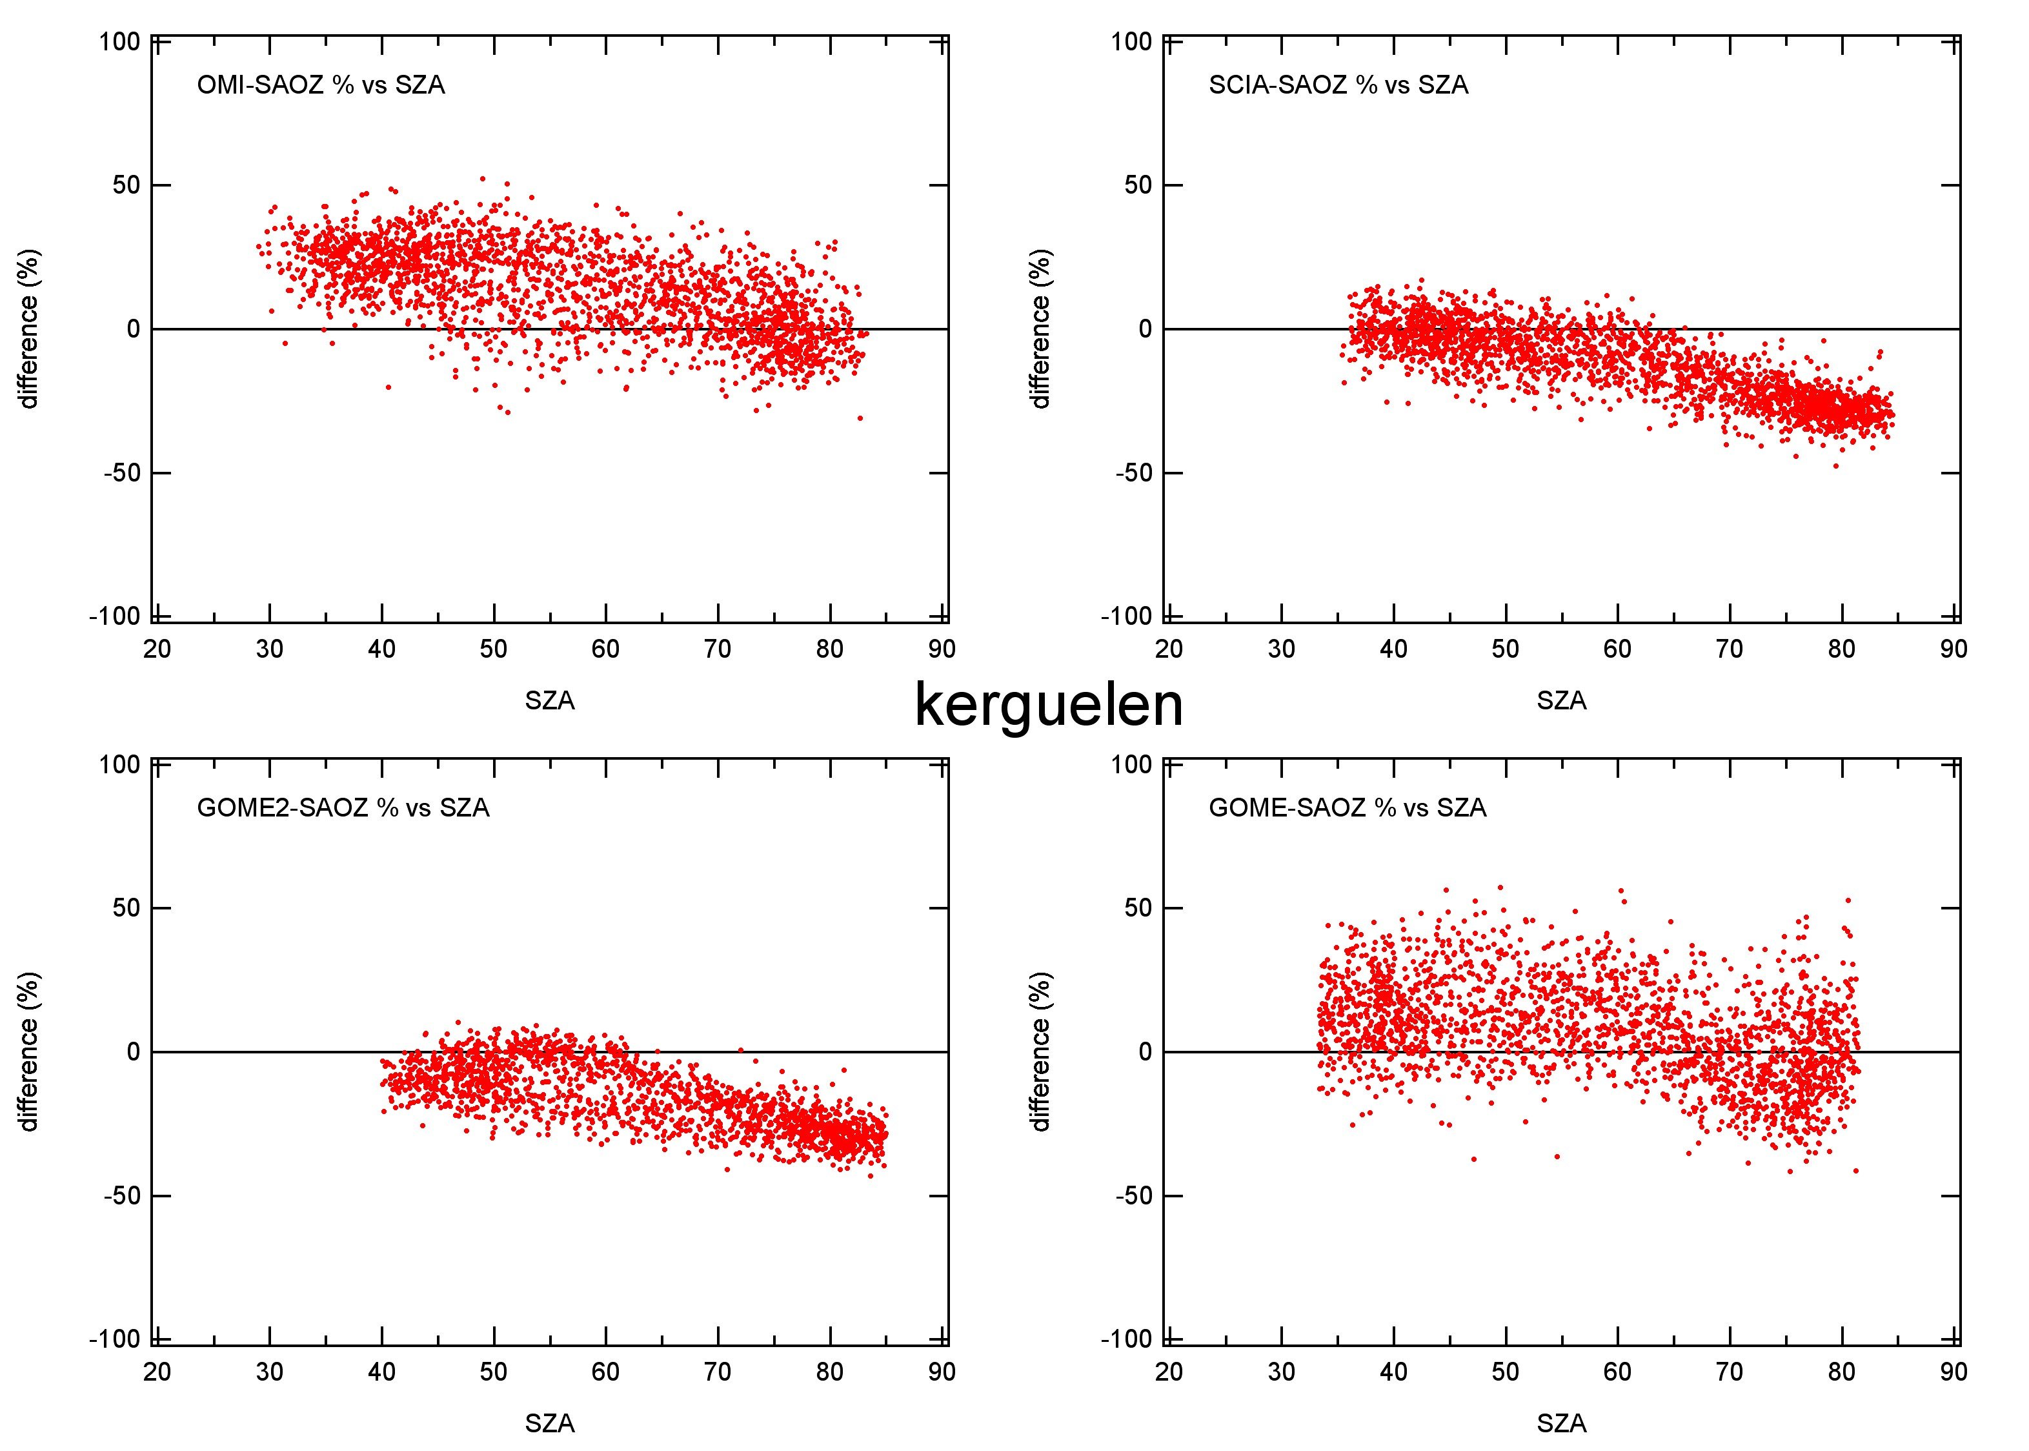
SZA DEPENDENCE
But in contrast to polar areas: high sun in the summer and low sun in the winter (daytime orbit only)
ESA ACVE March 2013

Slide 16
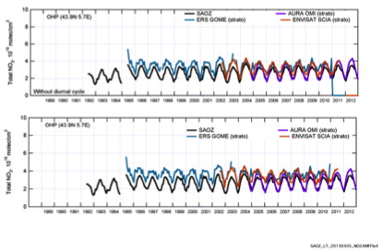
Mid-Latitude: OHP (PBL frequently polluted)
All satellites larger and noisier than SAOZ
ESA ACVE March 2013

Slide 17
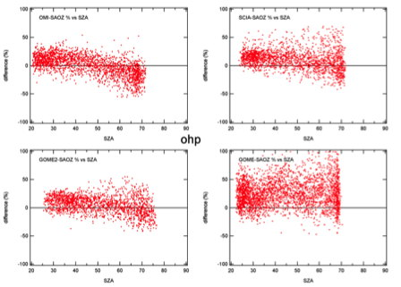
SZA DEPENDENCE
Similar to Kerguelen but larger summer high bias and noise on all satellites
Nadir viewing more sensitive to PBL than zenith sky SAOZ

Slide 18
TROPICS
Larger SAOZ column in Bauru compared to Reunion
(LNOx during thunderstorm summer, biomass burning and urban pollution in the winter)
Pastel PhD thesis 2011
ESA ACVE March 2013

Slide 19
Nitrogen Dioxide zonal anomaly between 10-20°S in the summer seen from a circum-navigating long duration ballon
LNOx
LNOx
REUNION
BAURU
Maximum over Africa and S.America
Pommereau 2007

Slide 20
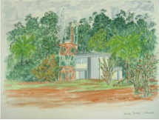
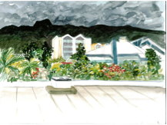
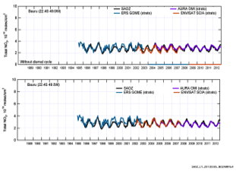
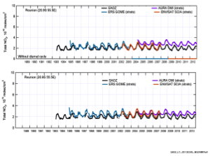
Satellites: no difference between Bauru and Reunion
Agreement SAT/SAOZ (except GOME)
(tropospheric NO₂ consistent)
All SAT larger than SAOZ, particularly OMI
(wrong tropospheric NO₂)

Slide 21
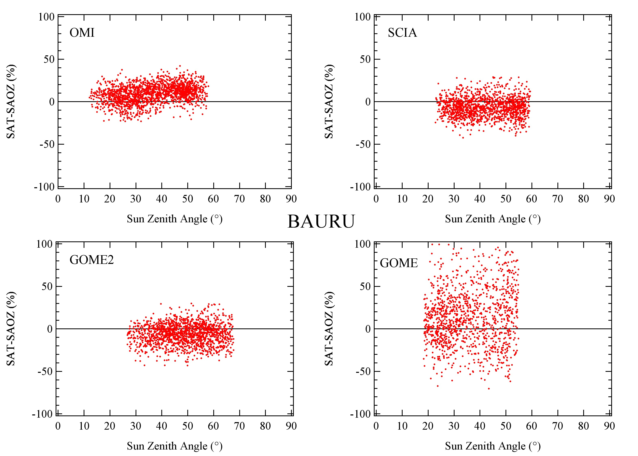
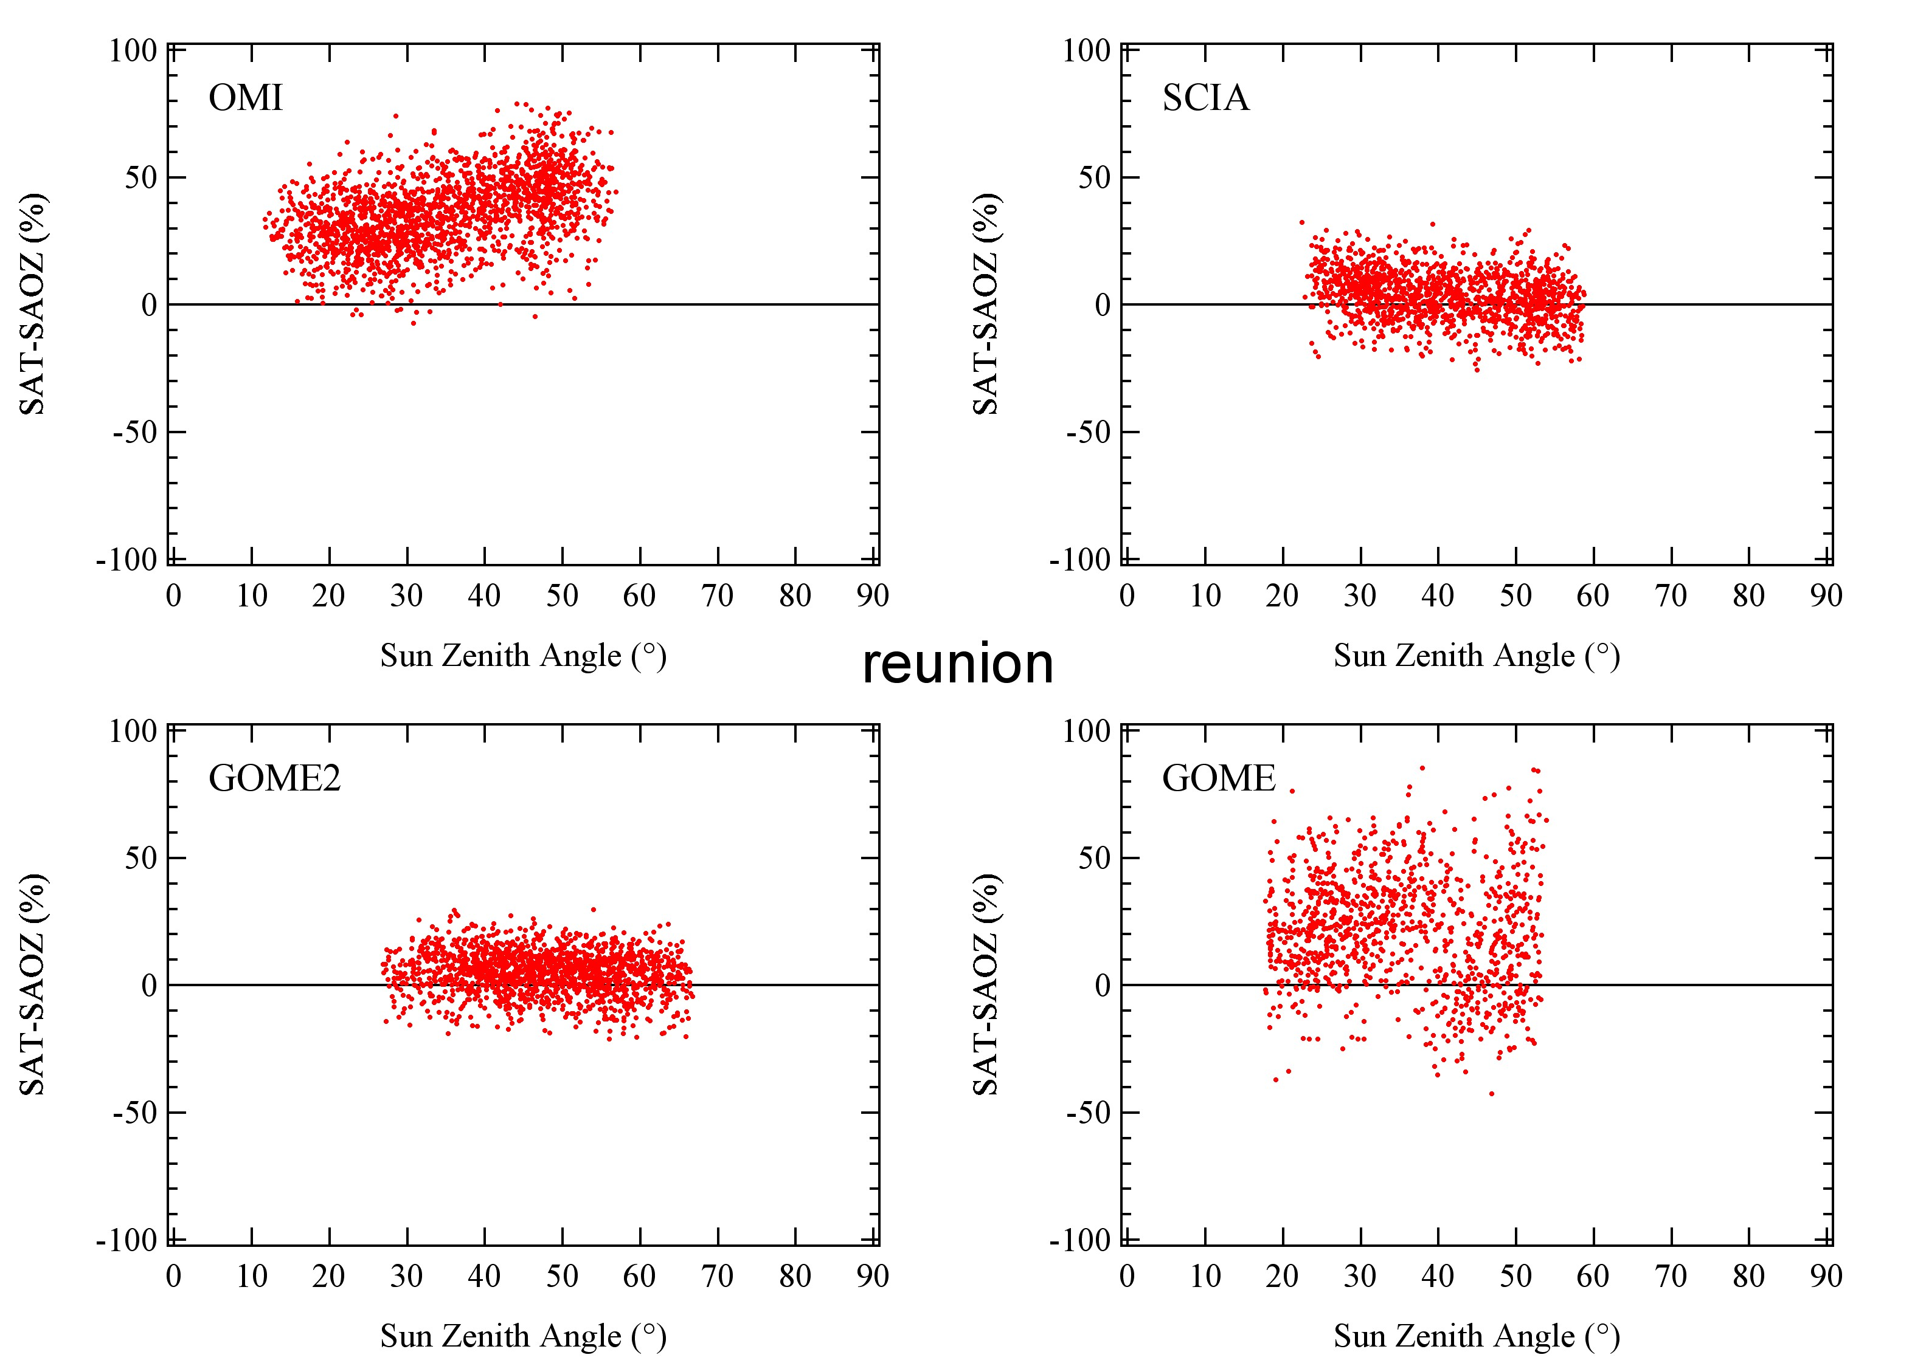
SZA DEPENDENCE
Bauru
Reunion
Smaller SCIA and GOME2 stratospheric columns: Tropospheric ozone overestimated.
Larger stratospheric columns: Tropospheric ozone underestimated (particularly OMI and GOME)

Slide 22
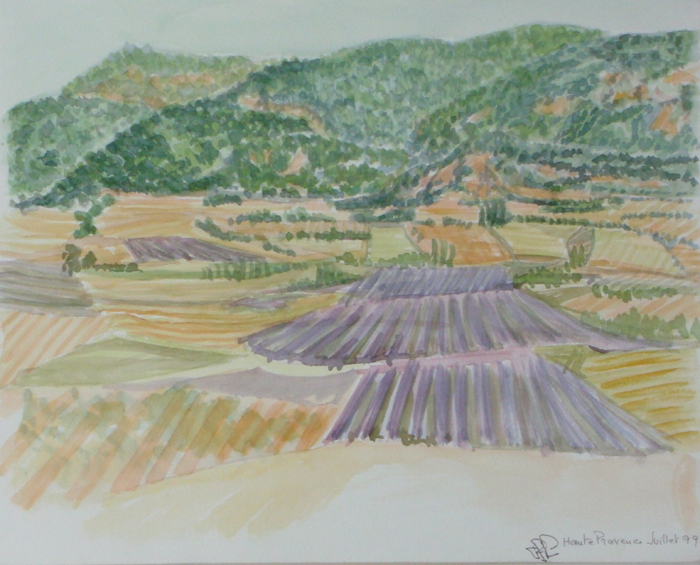
SUMMARY
Systematic seasonal differences (up to 30%) between satellites and SAOZ at all latitudes, attributed to:
SZA dependences of SAOZ- satellites difference (OMI largest, GOME smallest). Improved correction for diurnal variation and profiles climatology required.
Errors in tropospheric contributions estimations
Tropospheric contribution very difficult to separate in nadir observations

