Slide 1





Preliminary results of the seasonal ozone vertical trends at OHP France
Maud Pastel, Sophie Godin-Beekmann
Latmos CNRS UVSQ , France

Slide 2
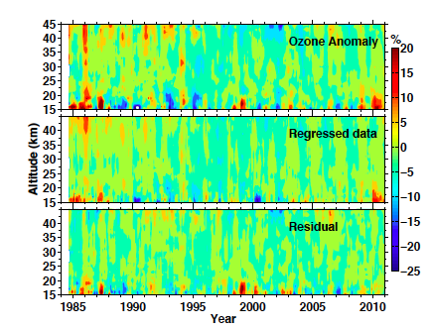
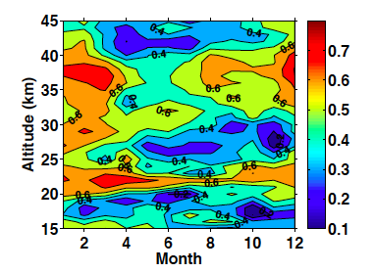
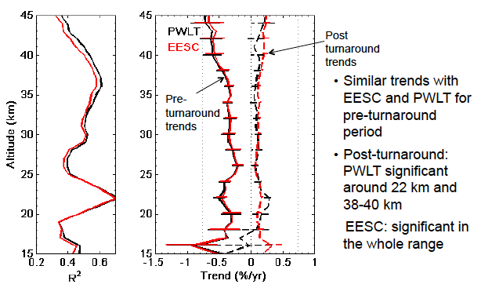
Previous study
Multiple regression analysis using QBO 10 , 30 hpa, NAO, SFX, HF, AOD 550nm (1985 to 2010)
2 methods : Piecewise Linear Trend ( PWLT) Equivalent Effective Stratospheric Clorine
Merged profiles: LIDAR v4, MLS, HALOE v19, SAGE II v6, OHP Soundings
R² as a function of
altitude and month
Similar trend results obtained between PWLT with turnaround in 1997 and EESC trend models
Ozone recovery visible on vertical profile time series but signal barely significant
Nair et al , ACP 2013

Slide 3
Present study (Preliminary)
New Lidar data
New satellites versions
Times series up to 2012 included
Update proxies until 2012 included
Use additionnal proxies
Seasonal analysis

Slide 4
Stratospheric profiles measurements
Satellites | Vertical resolution ( km) | Altitude ( km)
AURA MLS ( 2004 – 2012) L2GP-O3_v2.2 | 1 | 15 - 45
SAGE II (1986 – 2005) version 7a | 1 | 15 - 45
GOMOS (2002- 2011) version 5 | 1 | 18 – 45
ODIN (2001- 2011) version 2.1 | 2 | 18 - 44
MIPAS (2005 -2011) version 5R_O3_220 | 1 | 10 - 44
GOZCARDS (1986 -2012) version 1.01 | 2 | 14 - 44
GOZCARDS (Global OZone Chemistry And Related trace gas Data records for the Stratosphere) Merged of SAGE II, HALOE, Aura MLS, UARS MLS and ACE-FTS data sets
LIDAR data (new version: v 5.0) have been reprocessed from 1985 until now with the same temperature and pression profiles in order to get homogenous data. Data available on the NDACC data base (ames format, soon in HDF)
For each comparaisons with satellites, LIDAR data have been converted into the same vertical resolution

Slide 5
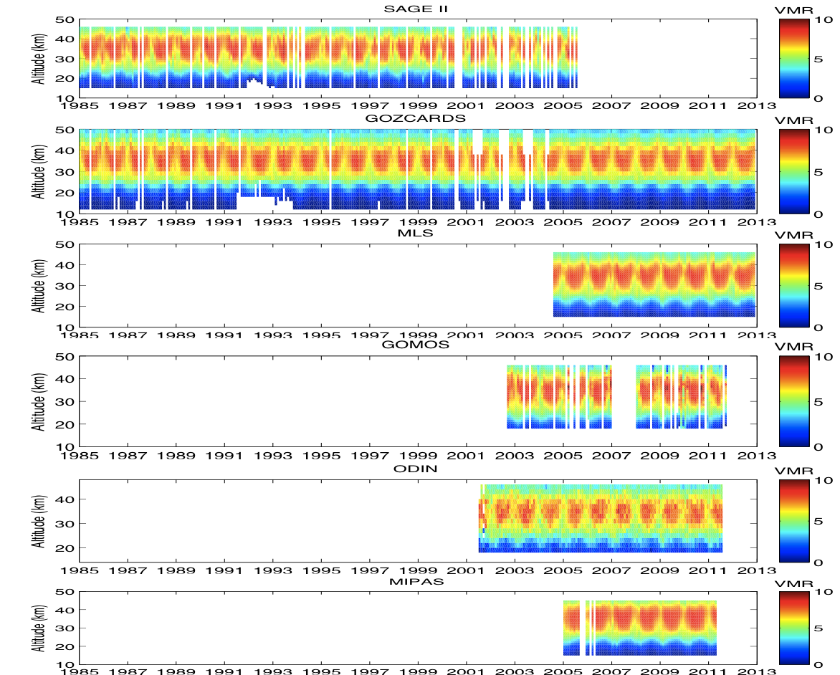
Monthly mean times series
LIDAR
SAGE II
Consistency between
SAGE II and GOZCARDS
GOZCARDS
ODIN is systematicaly lower than the LIDAR with a important bias from 28 to 40 km
Only MIPAS present a positive bias (of 4.6 %) from 35 to 45 km
MLS
GOMOS
ODIN
MIPAS

Slide 6
Data quality (Relative drift in %/yr)
ODIN
GOMOS
SAGE II
Avg=0.01%/yr
Avg=0.69%%/yr
Avg=-0.20%/yr
MIPAS
MLS
GOZCARDS
Avg=0.12%%/yr
Avg=0.46%/yr
Avg= -0.05%/yr
Drift generally within ± 0.5%.y-1 in 25 – 40 km range except Aura MLS and MIPAS
Long-term measurements stable at OHP latitude band ( non significant drifts except MIPAS)
Notes:
Data quality Stability of each satellites: investigation of the magnitude of the drifts by comparing all measurements with respect to LIDAR

Slide 7
Anomalies times series %
Between 16 to 21 km , all instruments present strong variations except GOZCARDS
LIDAR, MLS and GOZCARDS present the smallest variations

Slide 8
Spring (MAM) time series anomaly in %
LIDAR
GOMOS
SAGE II
MLS
ODIN
GOZCARDS

Slide 9
Summer (JJA) time series anomaly in %
LIDAR
GOMOS
SAGE II
MLS
ODIN
GOZCARDS

Slide 10
Autumn (SON) time series anomaly in %
LIDAR
GOMOS
SAGE II
MLS
ODIN
GOZCARDS

Slide 11
Winter (DJF) time series anomaly in %
LIDAR
GOMOS
SAGE II
MLS
ODIN
GOZCARDS

Slide 12
Regression analysis
Proxies used from 1985 to 2013
QBO
EESC and PWLT Monthly model
using multiple proxies
(autocorrelation taken into Account)
Proxies used:
- QBO (30 & 10 hPa)
NAO index
F10.7 cm Solar flux
Heat flux at 100 hPa averaged
over 45-75°N
Aerosols optical thickness at 550 nm
Tropopause altitude above OHP
Solar flux
NAO
Heat flux
Aerosols
Tropopause
Applied on LIDAR and the merged of all the satellites with the lidar
Notes:
EESC or PWLT (piecewise linear
trend with turning point at end of
1996)

Slide 13
LIDAR Variability due to model proxies
QBO significant mainly in
winter months (easterly phase)
Aerosols: significant
at all month and
Altitudes
Solar flux: significant
in summer in midstratosphere
NAO mainly
signifcant in winter
Heat flux and tropopause:
significant mainly in lower
Stratosphere

Slide 14
Regression analysis
LIDAR
Merged of all the data
Strong variations:
LIDAR residual above 40 km ( seasonal variation ?)
Merged data below 18 km

Slide 15
O₃ Variability explained
LIDAR
Merged of all the data
Variability of O3 less explained above 35 km in Spring and Summer
Below 20 km , variability more explained with LIDAR data except in October
Notes:
Variabilité faible a 25 KM

Slide 16
Ozone vertical distribution trends
LIDAR
Merged of all the data
Post
turnaround
trends
Pre-
Turnaround
trends

Slide 17
Spring ozone vertical distribution trends
LIDAR
Merged of all the data
Post
turnaround
trends
Pre-turnaround:
LIDAR PWLT and EESC
significant around
15-20 km
Pre-
Turnaround
trends

Slide 18
Summer ozone vertical distribution trends
LIDAR
Merged of all the data
Post
turnaround
trends
Pre-turnaround:
LIDAR PWLT and EESC
significant around
15-20 km
Pre-
Turnaround
trends

Slide 19
Autumn ozone vertical distribution trends
LIDAR
Merged of all the data
Post
turnaround
trends
Pre-turnaround:
PWLT and EESC significant:
LIDAR: 30-45 km Merged : 24-45 km
Pre-
Turnaround
trends
Both data set:
Similar trends with EESC and PWLT for post-turnaround period for both data except below 20 km

Slide 20
Winter ozone vertical distribution trends
LIDAR
Merged of all the data
Post
turnaround
trends
Both data:
Pre-turnaround:
PWLT and EESC significant
From 24-45 km
Pre-
Turnaround
trends
Similar trends with EESC and PWLT for post-turnaround period for both data

Slide 21
Conclusions
Evaluation of long-term ozone trend at OHP using multiple regression analysis for the period 1985 – 2013
LIDAR, SAGE II, GOZCARDS and MLS present the smallest anomalies for 1985 to 2013
All Satellites anomalies agree well with the lidar, with average biases of less than ± 5%, in the 20–40 km range
Significant pre-turnaround trend depending on the season
Post-turnaround increase but mainly unsignificant
Outlook
Introduction of Umkehr and SBUV II in the present study
Used the equivalent latitude in the regression analysis ( might explain the significant pre-turnaround trend during the Winter period

Slide 22
Thank you for your attention
Thanks to
GOZCARDS team ( NSA , Jet Propulsion Laboratory
The NASA Langley Research Center (NASA-LaRC) for provinding SAGEII data
Dr. Alexandra Laeng at Karlsruher Institut fur Technologie (KIT) for MIPAS data
Dr. Joachim URBAN at Chalmers University of Technology (GOTHENBURG) for ODIN data
Dr Alain Hauchecorne at LATMOS ( France) for GOMOS data
Dr Lucien Froideveaux ( NSA , Jet Propulsion Laboratory) for AURA MLS data.
for providing the data

