Slide 1





NORS project
(Network Of ground-based Remote Sensing Observation )
Contribution of the CNRS LIDAR team
Maud Pastel, Sophie Godin-Beekmann
Latmos CNRS UVSQ , France

Slide 2
NORS project
Start Nov. 1, 2011
Duration: 33 months
Aims:
Perform the required research and developments to optimize the NDACC data and data products
Demonstrate the value of ground–based remote sensing data for quality assessment and improvement of the Copernicus Atmospheric Service products CAS (MACC-II as prototype ( Monitoring Atmospheric composition & climate)
NORS is a demonstration project
target NORS data products
  tropospheric and stratospheric ozone columns and vertical profiles up to 70 km altitude;
  tropospheric and stratospheric NO2 columns and profiles;
  lower tropospheric profiles of NO2, HCHO, aerosol extinction;
  tropospheric and stratospheric columns of CO
  tropospheric and stratospheric columns of CH4
4 NDACC techniques:
  LIDAR, MW, FTIR, UV-VIS DOAS and MAXDOAS

Slide 3
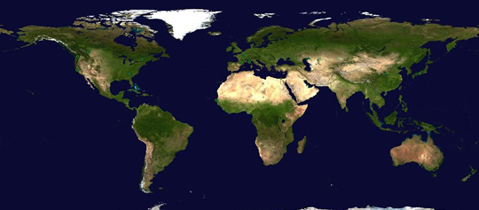
NORS project
4 NDACC pilot stations
Apart from some MAXDOAS data, none of the NORS data are already included in MACC-II VAL.
NORS is complementary to validation included in MACC-II
NORS will aim at consistency with validation protocols and procedures defined in MACC-II (at management level and in VAL subproject)
Ny Alesund
Alpine stations
Izaña
La Réunion

Slide 4
NORS objectives
Rapid data delivery to NDACC with a delay of maximum 1 month
ftp://ftp.cpc.ncep.noaa.gov/ndacc/RD/
Promote NORS data as validation data for the Copernicus Atmospheric Service products: provide an extensive characterisation of targeted NDACC data and user documentation
Investigate the integration of ground-based data products from various sources (ground-based in-situ surface and remote-sensing data, and satellite data)
Provide ground-based measurement time series back to 2003 in support of the re-analysis products of CAS.
Develop and implement a web-based application for validation of MACCII products using the NORS data products.
Capacity building:
    To ‘export’ project achievements to whole NDACC community
    To support the extension of NDACC to stations outside Western Europe, namely in the tropics, in China, Latin America, Africa and Eastern Europe

Slide 5
CNRS Contribution: Re–analysed O3 profiles
Define the content : Homegenisation of the O3 LIDAR NDACC data
Use the ISSI (International Space Science Institute, Bern) project recommendation regarding the homogeneisation of the characterisation of the LIDAR vertical resolution and uncertainties (lead by Thierry Leblanc)
Use the recommendation of the IGACO –O3 activity: ACSO (Absorption Cross Sections of Ozone)
Define the Temperature et Pressure Model used for the data base.
An extensive characterisation (metadata) of O3 LIDAR data and user documentation can be found
At http://nors.aeronomie.be
Define the format for the delivery : HDF GEOMS
Location, time and duration provided
O3 number density
Altitude resolution of O3 number density
O3 mixing-ratio profile provided
O3 mixing-ratio profile provided
O3 column provided
Related uncertainty
LIDAR HDF GEOMS template can be find at
http://avdc.gsfc.nasa.gov/

Slide 6
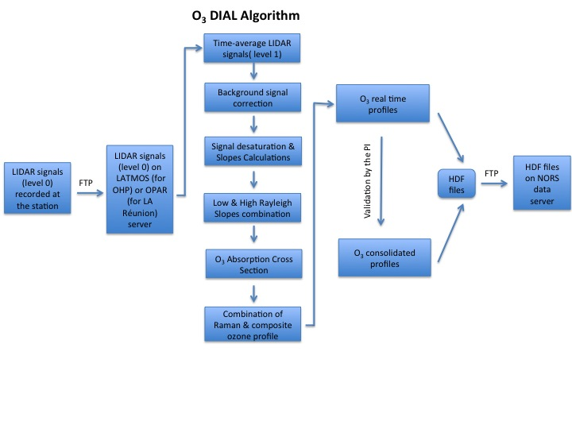
CNRS Contribution: Delivery
Implementation of procedures for operational delivery of NRT NDACC LIDAR data to the NORS data server with a delay of maximum 1 month after data acquisition
Use of a common HDF format compliant with GEOMS
(Generic Earth Observation Metadata Standard) guidelines
OHP NRT data available on the NDACC website from 2012 until now
Delivery of consolidate data from 2003 by the end of the year 2013

Slide 7
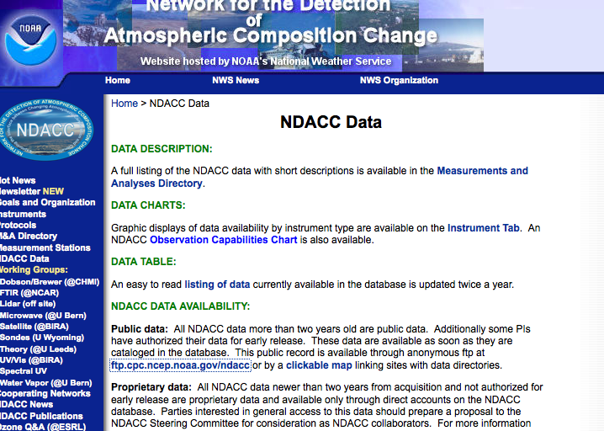
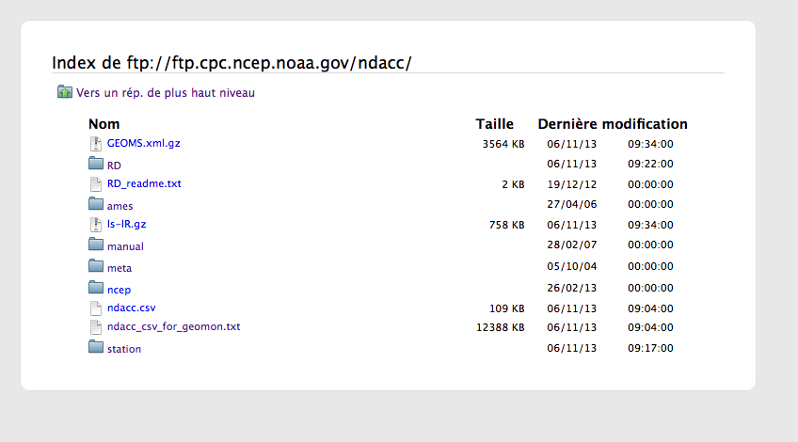
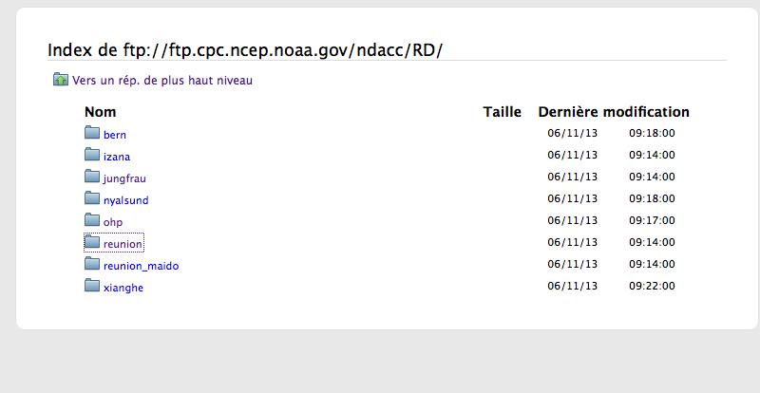
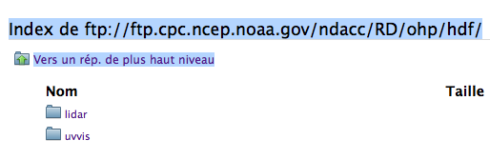
CNRS Contribution: Delivery

Slide 8
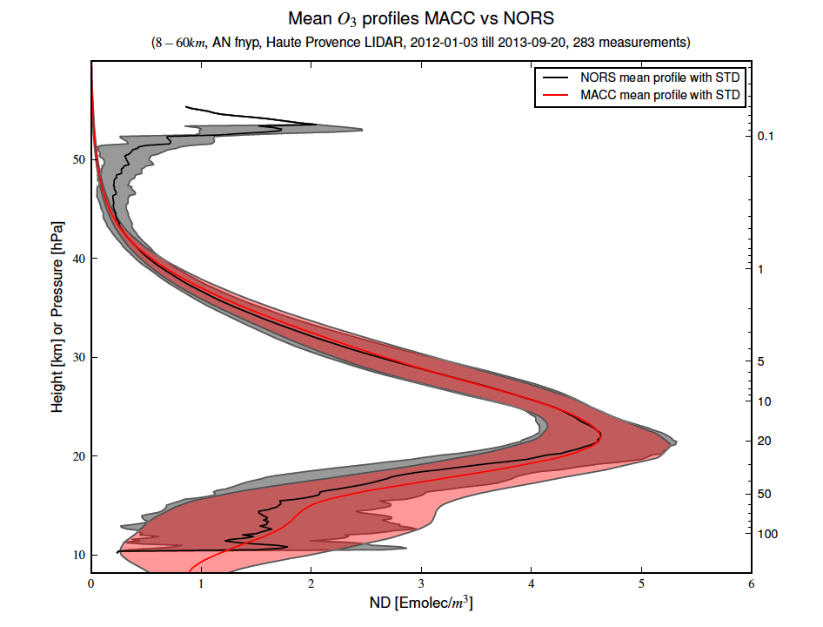
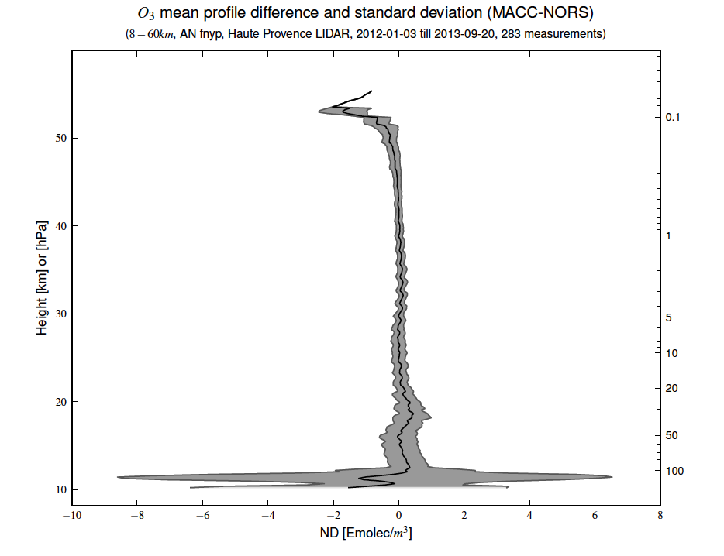
CNRS Contribution: Delivery
Comparison between MACC II data and NRT lidar profiles

Slide 9
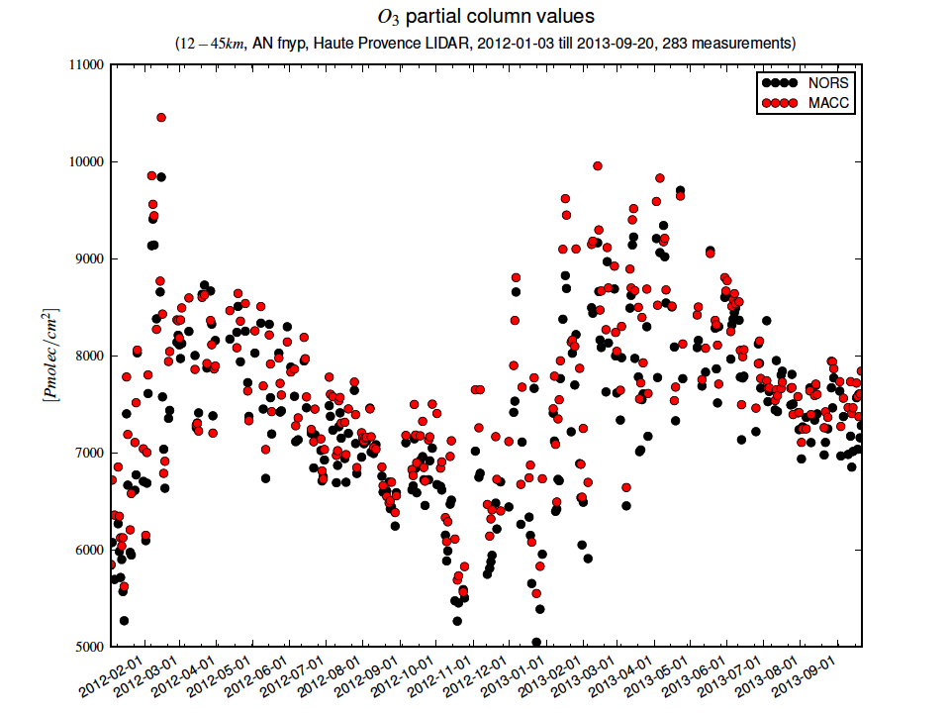
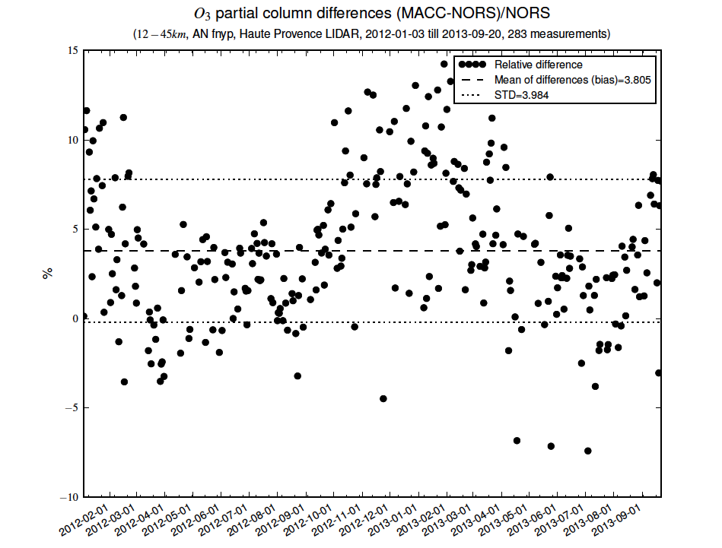
CNRS Contribution: Delivery
Comparison betwwen MACC II data and NRT lidar partial column
Seasonal variation well
reproduced by the model
MACC II column larger
than the LIDAR NRT
Website under construction, will be release soon

Slide 10
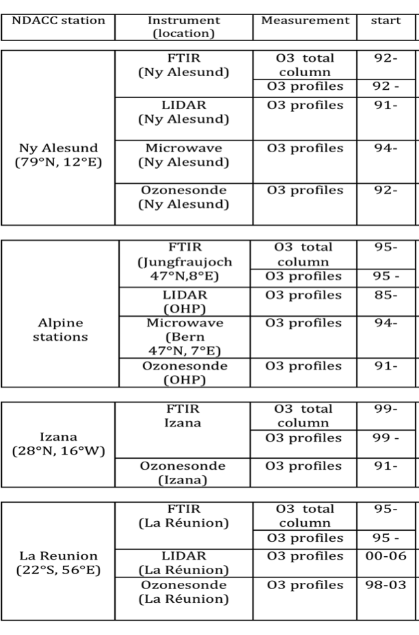
CNRS Contribution: Integration of ozone products
Develop a methodology for integrating ground-based data sources and provide consistent ozone vertical distribution time series as well as stratospheric ozone columns at the 4 NDACC stations.
Ny Alesund
Alpine stations
Izaña
La Réunion
00-

Slide 11
CNRS Contribution: Integration of ozone products
Evaluate the validity domain of ozone profile data
Hightlight O₃ measurements bias between
LIDAR, FTIR and MicroWave
Understand and characterize the origin of those biases
statistical tool for the profiles integration
For Ny Alesund
Izana
La Réunion
For the alpine station
Basic integration using
MW resolution as reference
Neural network approach
Resulting profiles
O3 (z)= Σ (W_{error}(z)*correction_bias(z))*O3 _{stations}(z)
O3 (z)= Σ (w_{eq}(z)*W_{error}(z)*correction_bias(z))*O3 _{stations}(z)

Slide 12
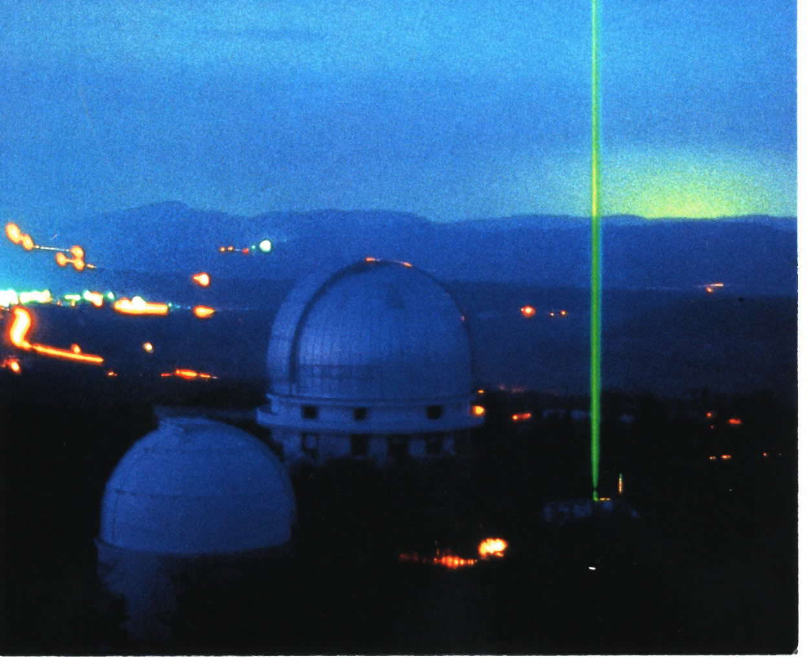
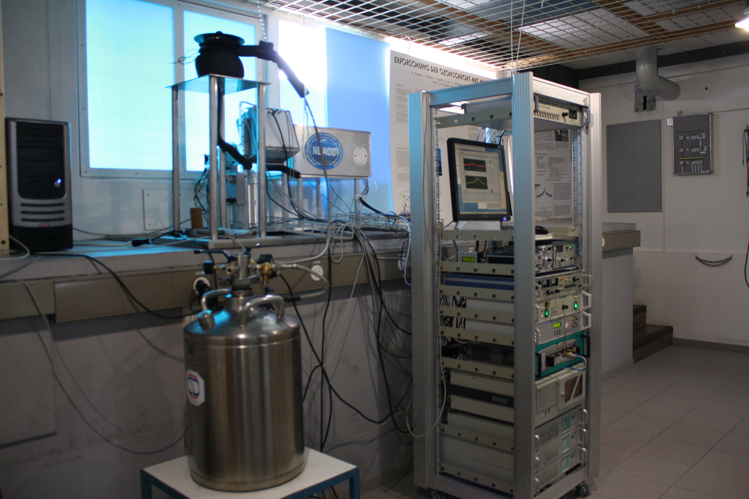
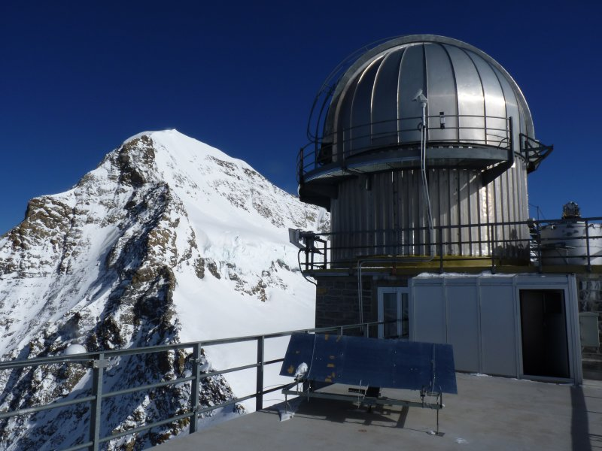
Microwave at Bern
(47°N, 7°E)
FTIR Jungfraujoch
(47°N, 8°E)
LIDAR at OHP
(44°N, 6°E)
DIfferential Absorption Lidar technique for stratospheric ozone measurements
(GROund-based Millimeter-wave Ozone Spectrometer)
(high-resolution Fourier transform InfraRed)
Active technique
Emission of two laser radiation at wavelengths characterized by a different ozone absorption cross section (308nm and 355 nm)
Passive technique
Measures the ozone transition at 142.175 GHz
Passive technique
The measurements performed over a wide spectral range (around 600–
4500 cm−1 ) using high-resolution spectrometers Bruker

Slide 13
Evaluate the validity domain of ozone profile data
Active remote sensing
Passive remote sensing
LIDAR at OHP
Microwave at Bern
FTIR Jungfraujoch
Retrieved profile is closed to the apriori profile
 | Spectral range | Altitudes (km) | Resolution( km) | Precision (%)
LIDAR (1985-2012) | UV | 10-45 | 1-4.5 | 2-10
MicroWave (1994-2001) | UV | 20-76 | 10-15 | 5
FTIR (1989-2012) | IR | 3.7-93.4 | 7-15 | 4.2

Slide 14
Construction of the future database from 2003 until now
 | Occurence | Temporal resolution
LIDAR | Clear sky | Every night (4 hours)
Microwave | Every day | Every 2 hours
FTIR | 1-2 per day | Every morning
Z
Ideal Case
The most likely
60 km
The less likely
40 km
LIDAR
FTIR
MW
FTIR
MW
LIDAR
FTIR
10 km
5 km
284 profiles (32 profiles/ yr) | 850 profiles (95 profiles/ yr) | 390 profiles (44 profiles/ yr)

Slide 15
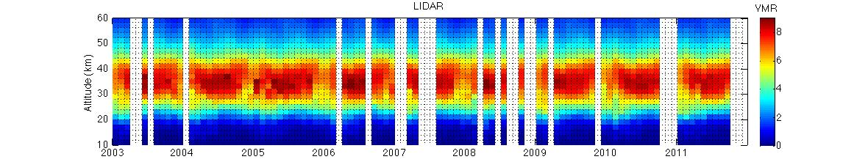
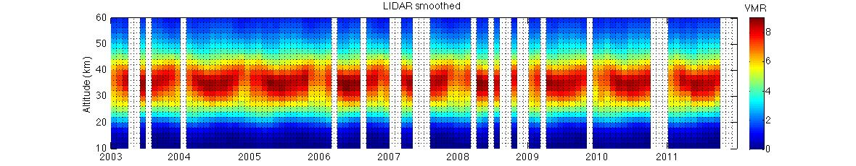
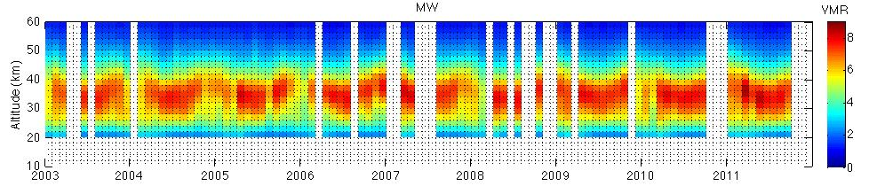
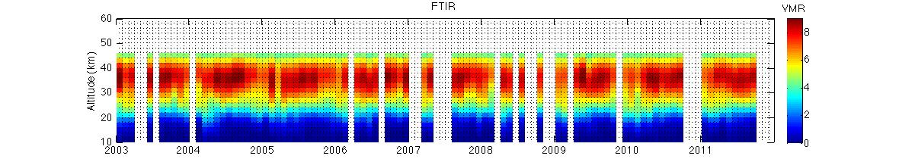
O₃ monthly mean times series of LIDAR, MW and FTIR profiles (Coincident date)
LIDAR
LIDAR smoothed
MW
FTIR
Altitude of the maximun O3 less pronounced with MW measurements

Slide 16
Comparison of the times series , MW as reference (Coincident date)
LIDAR - MW
LIDAR smoothed - MW
FTIR- MW
Bias more pronounced with unsmoothed LIDAR data
Seasonal variation of the difference above 35 km

Slide 17
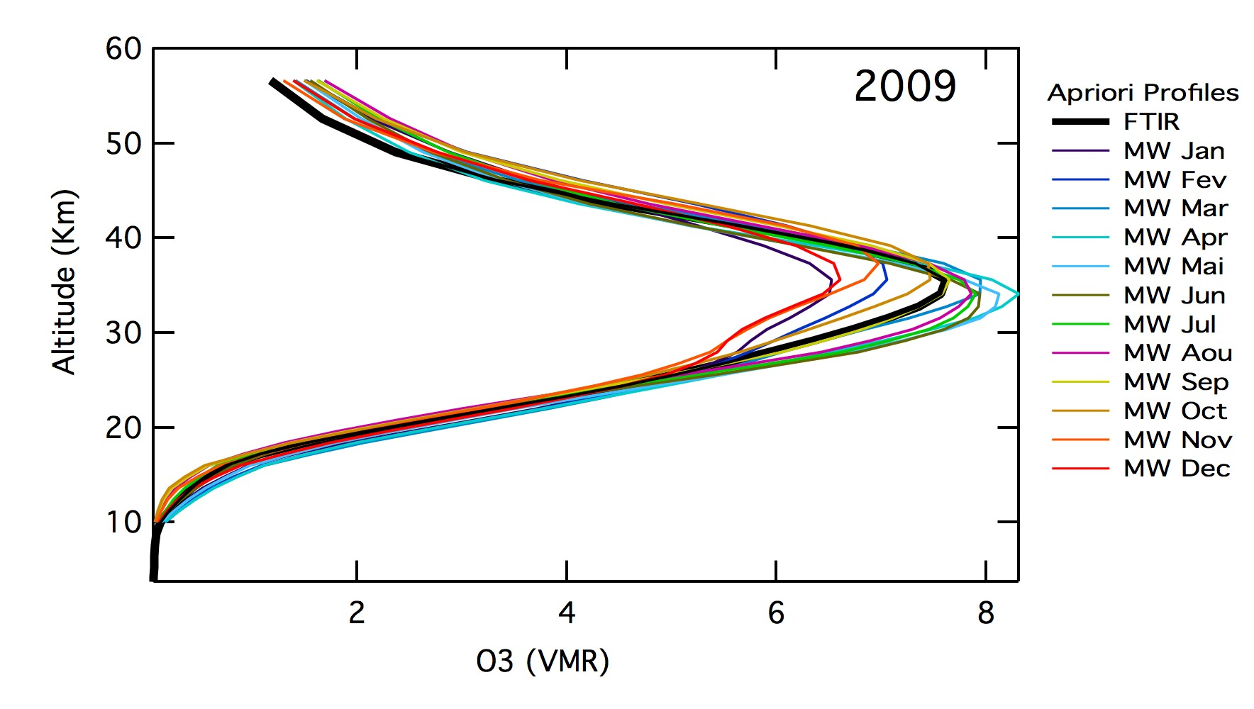
Origine of bias between FTIR and MW = apriori profiles ?
Apriori profiles
FTIR Yearly climatology between 1995 -1999 (Barret et al., 2003) Above 3.6 km up to 23 km ozone soundings at Payerne (6.95°N; 46.80°E) profile up to 70 km : the microwave data | MW Monthly climatology ECMWF 1994-2012 Lower 20hpa AURA_MLS 2005_2012 Higher 20 hpa
MW winter profile systematicaly lower than FTIR= origin of the season variation
Modification of FTIR apriori profiles (correction of the bias between apriori profiles)
Correction of FTIR apriori profiles
Before
FTIR- MW
After
No more seasonal variation of the differences

Slide 18
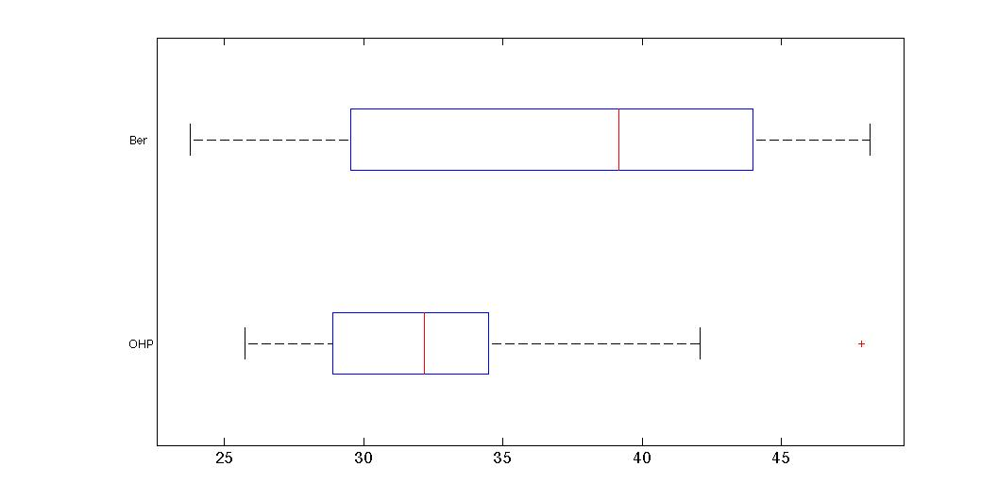
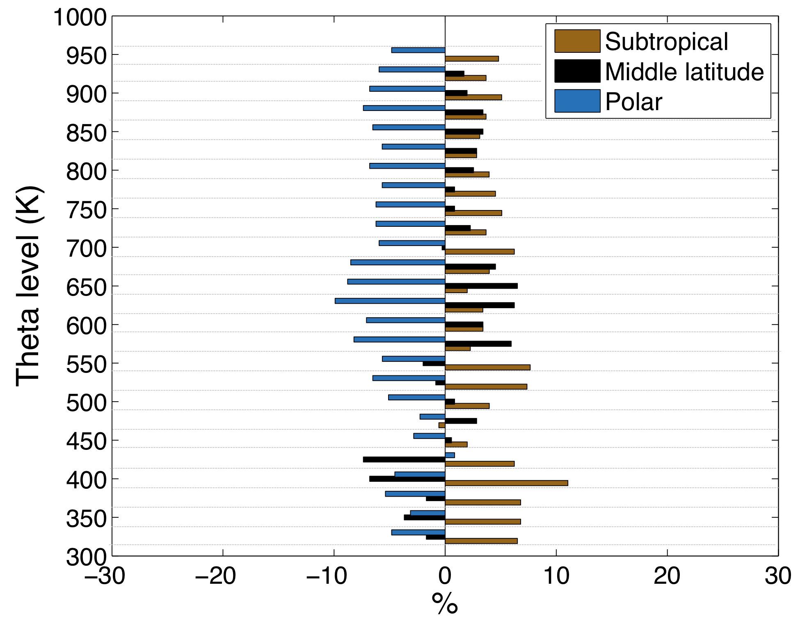
0rigin of the biases between each stations
Origine of the Bias between FTIR and MW: instrumental
Origine of the Bias between OHP and Bern/Jungfrauch : air mass ?
Air Mass above OHP and Bern : altitude range ( 325- 950 K) for one day in January
Difference of the origin of the air masse
between OHP and Bern for one year
Bern
OHP-BERN
OHP
Variation above Bern more pronounced than OHP
Similar min extrema
Max extrema larger ( 10 °) at Bern
Mean difference
Subtropical = 4± 2.3 %
Middle Latitude= 1± 3.1%
Polar=-6± 2.2%

Slide 19
Methodology for integrating ground-based ozone profile data
Define altitude levels where the difference between air mass above each station is the largest.
Define the position (lat/lon) of the new alpine station
and it corresponding Equivalent latitude profile
Use a neural network approach on the Equivalent
latitude to assign OHP and Bern weight which will
correspond to the proximity of the new alpine
station’s equivalent latitude.
Attribution of the station weights at each altitude
Advantages | Inconvenience
The position of the target station is flexible. Can provide daily monthly and yearly profile Robust methode to identify weights Method optimised for data series | Require external data (latitude equivalent)
Alpine station time series expected by the end of 2013
Notes:
CATO has
been reconstructed from TOMS, GOME and SBUV total column
ozone observations in an equivalent latitude and potential
temperature

Slide 20
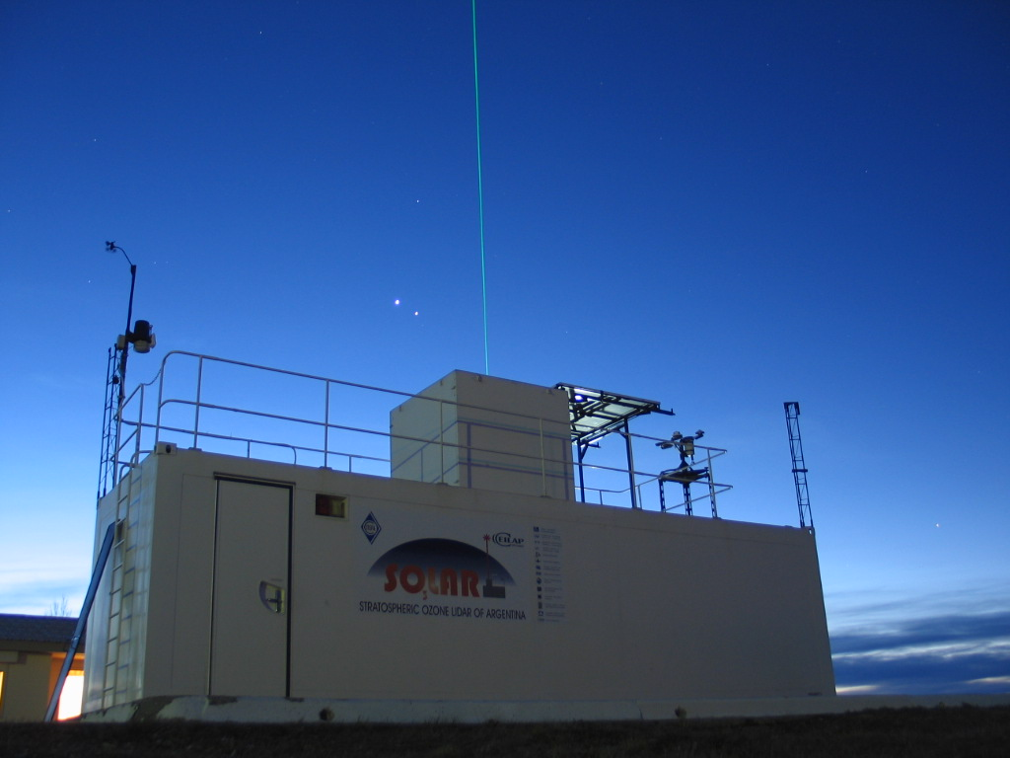
CNRS Contribution: Capacity building
  Import automated LIDAR data retrieval at Rio Gallegos (lat : 51.6°S lon : 69.3°W)
A scientist from Argentina has been trained to work on the data retrieval
Rio Gallegos Site (CEILAP-RG)
Province of Santa Cruz, Argentine Patagonia.
Promote the achievements of NORS in lidar WG
Check !!!

Slide 21
Thank you
For futher informations
http://nors.aeronomie.be
ftp://ftp.cpc.ncep.noaa.gov/ndacc/RD/

Slide 22
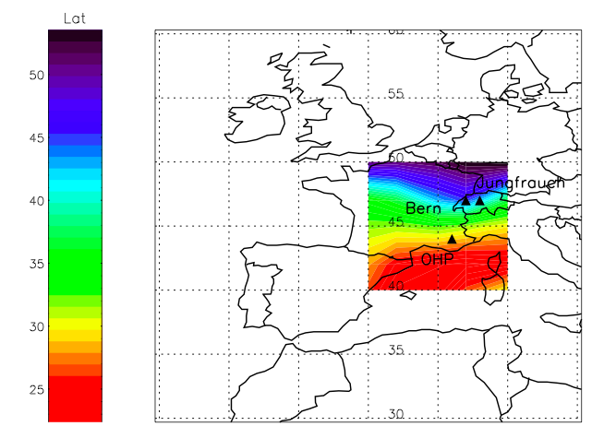
Used of the Self-Organizing Map (SOM) for the Alpine stations
The input parameter = 3D matrix ( lat, lon, Equivalent Latitude)
Lat=from 40 to 50 °
Lon=from 0 to 10 °
Exemple for one day in January at 500k
Alpine station target= locations ( 45°N, 7 °E)
After training the node map, the procedure is to place the vector target from data space onto the map and find
All the node with the closest (smallest distance metric) weight vector to the data space vector.
Find OHP and Bern nods and identifiy/retreived their weight vector from the target.

Slide 23
Assimilation phase
For one day at 500k
Each neighbouring node's weights are adjusted to make them more like the input vector
1 nod = 1 configuration
Lat
Lon
Equivalent Latitude
Determining the Best Matching Unit's Local Neighbourhood
Calculate the Euclidean distance between each node's weight vector and the target vector

